Slide 1
Project
R and Power BI Project

Slide 2

Camera Expectations

Slide 3



Before we start… Please have your camera switched on.
Camera Expectations
This is a mandatory requirement for the duration of the course.
You are studying a regulated qualification, your tutor needs to see that it is the right person participating throughout the course.
Our job is to prepare you for work in an age where in almost any job there is likely to be at least some aspect of remote engagement with your employer.
Online learning is to be treated the same way as a classroom learning, you must be physically visible to interact with your tutor and other learners in order to create an engaging group dynamic.

Slide 4
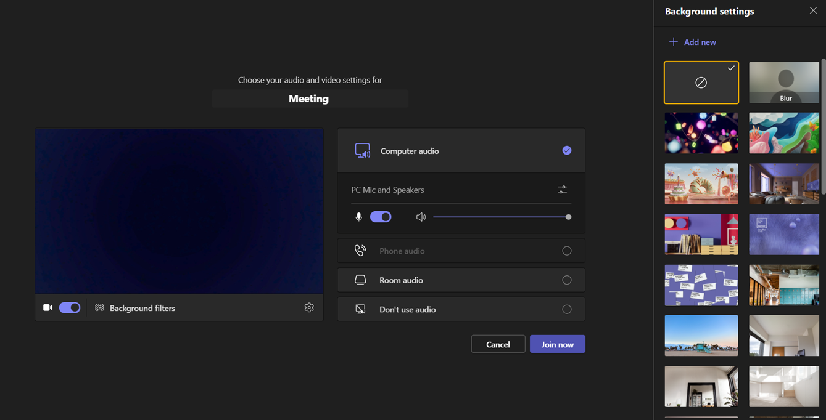
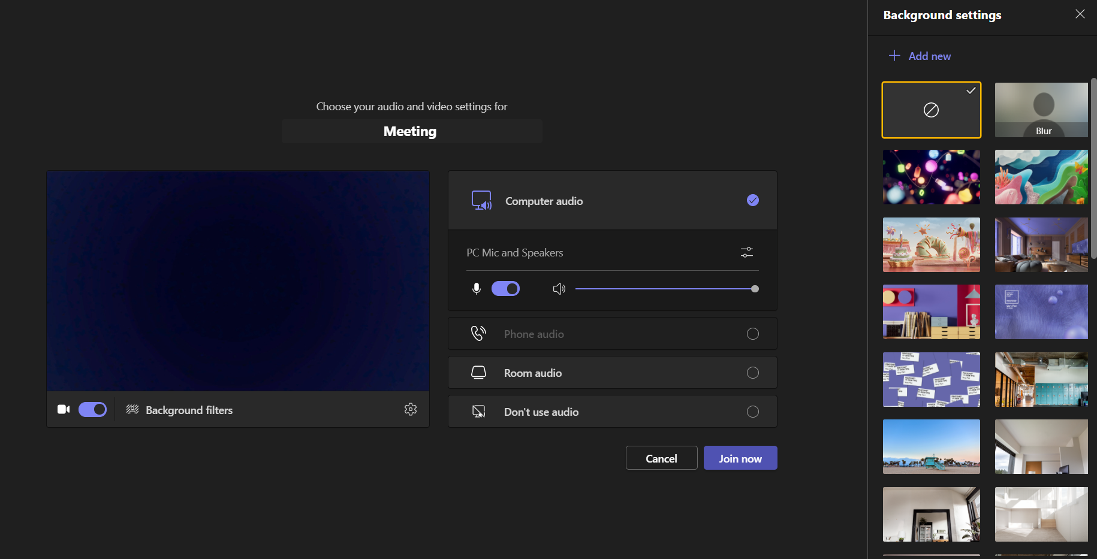
Background filters
If you do not wish to have your camera displaying your personal environment, Microsoft Teams has a solution to this problem…
Step One: Before you join a Teams video call, click the ‘Background Filters’ option.
Step Two: On the right-hand side, you can select any of the stock images.
Step Three: The image you choose will then appear in your background on the video call.
If you need any further support in regards to this requirement, please speak to your tutor directly.

Slide 5

Aim: To analyze the performance of Hollywood movies
Data: Title, genre, studio, profitability and ratings for movies released 2007-2012. Source: InformationIsBeautiful.net Download data from this link:
https://public.tableau.com/app/sample-data/HollywoodsMostProfitableStories.csv
Tip: Windows users, press control and then click the link. Mac users, press command and then click the link.

Slide 6
Step1: Initial Exploratory Analysis
#Load data
df<- read.csv("/cloud/project/HollywoodsMostProfitableStories.csv")
#Take a look at the data:
View(df)
#Load library:
install.packages("tidyverse")

Slide 7
#Import library
library(tidyverse)
# Check data types:
str(df)

Slide 8
Step 2: Clean Data
# Check for missing values:
colSums(is.na(df))
#Drop missing values
na.omit(df)
# check to make sure that the rows have been removed
colSums(is.na(df))

Slide 9
#Check for duplicates
dim(df[duplicated(df$Film),])[1]
#round off values to 2 places
df$Profitability <- round(df$Profitability ,digit=2)
df$Worldwide.Gross <- round(df$Worldwide.Gross ,digit=2)
#View(df)
dim(df)

Slide 10
Step 2.1: Outlier removal
#Check for outliers using a boxplot
library(ggplot2)
#Create a boxplot that highlights the outliers
ggplot(df, aes(x=Profitability, y=Worldwide.Gross)) + geom_boxplot(outlier.colour = "red", outlier.shape = 1)+ scale_x_continuous(labels = scales::comma)+coord_cartesian(ylim = c(0, 1000))

Slide 11
#Remove outliers in 'Profitability'
Q1 <- quantile(df$Profitability, .25)
Q3 <- quantile(df$Profitability, .75)
IQR <- IQR(df$Profitability)
no_outliers <- subset(df, df$Profitability> (Q1 - 1.5*IQR) & df$Profitability< (Q3 + 1.5*IQR))
dim(no_outliers)

Slide 12
# Remove outliers in 'Worldwide.Gross'
Q1 <- quantile(no_outliers$Worldwide.Gross, .25)
Q3 <- quantile(no_outliers$Worldwide.Gross, .75)
IQR <- IQR(no_outliers$Worldwide.Gross)
df1 <- subset(no_outliers, no_outliers$Worldwide.Gross> (Q1 - 1.5*IQR) & no_outliers$Worldwide.Gross< (Q3 + 1.5*IQR))
dim(df1)

Slide 13
Step 3: Exploratory Data Analysis
#Summary Statistics/Univariate Analysis:
summary(df1)
#bivariate analysis
#scatterplot
ggplot(df1, aes(x=Lead.Studio, y=Rotten.Tomatoes..)) + geom_point()+ scale_y_continuous(labels = scales::comma)+coord_cartesian(ylim = c(0, 110))+theme(axis.text.x = element_text(angle = 90))
#bar chart
ggplot(df1, aes(x=Year)) + geom_bar()

Slide 14
Step 4: Export data
#Export clean data
write.csv(df1, "clean_df.csv")

Slide 15
Tips:
Import clean_df in Power BI.
Feel free to add more charts apart from the ones mentioned in the next slide.
For the dashboard, the company would like you to use their brand colors which are blue, green and brown. You can use light or dark shades of each color. For example, light blue and dark blue are acceptable. You can combine these colors any way that you like. For example, you can use only blue and green if you want to.

Slide 16
Step 5: Create Power BI Dashboard
In your power BI Dashboard, the client would like to see:
The average Rotten Tomatoes ratings of each genre
The number of movies produced per year
The audience score for each film
The profitability per studio
The worldwide gross per genre

